Slide 1

CheckPoint1: Web Fundamentals
Safwan TALEB

Slide 2
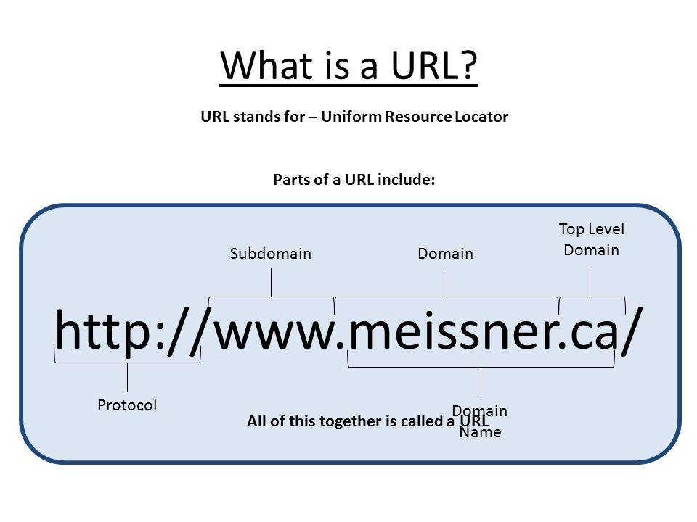
What is the World Wide Web (Web)?
World Wide Web (WWW), byname the Web, the leading information retrieval service of the Internet (the worldwide computer network). The Web gives users an easy access to a vast array of documents and other web resources (images, sounds, animations, movies…) that are connected to each other by means of hypertext or hypermedia links and identified by Uniform Resource Locators (URLs, such as https://gomycode.tn/) which are accessible over the Internet.

Slide 3
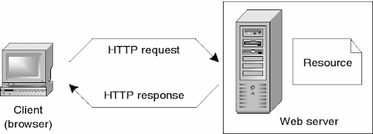
How does the Web works?
The Web operates within the Internet’s basic client-server format; servers are computer programs that store and transmit documents to other computers on the network when asked to, while clients are programs that request documents from a server as the user asks for them.
The resources of the Web, may be accessed by users by a software application called a web browser (Google Chrome, Firefox, Safari…), are transferred via the Hypertext Transfer Protocol (HTTP) which is the protocol that web browsers and web servers use to communicate with each other over the Internet.

Slide 4
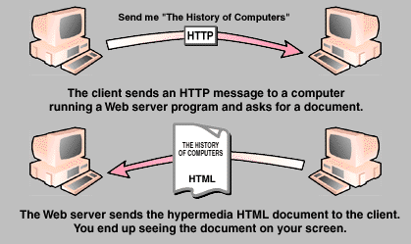
How does the Web works?
PS: Do not confuse HTTP (Hypertext Transfer Protocol) with the Hypertext Markup Language (HTML) which is the language used to write web pages.

Slide 5
How does the Web works?
In addition to what we mentioned previously, we also need to say hello to:
The internet connection: Allows you to send and receive data on the web. It's basically like the street between your house and the shop.
TCP/IP: Transmission Control Protocol and Internet Protocol are communication protocols that define how data should travel across the internet.
DNS: Domain Name Servers are like an address book for websites. When you type a web address in your browser, the browser looks at the DNS to find the website's real address before it can retrieve the website. The browser needs to find out which server the website lives on, so it can send HTTP messages to the right place.
DHCP: Dynamic Host Configuration Protocol is a network management protocol, whereby a DHCP server dynamically assigns an IP address and other network configuration parameters to each device on the network, so they can communicate with other IP networks.

Slide 6
How does the Web works?
As a Conclusion, when you type a web address (URL) into your browser:
1- The browser goes to the DNS server, and finds the real address of the server that the website lives on.
2- The browser sends an HTTP request message to the server, asking it to send a copy of the website to the client. This message, and all other data sent between the client and the server, is sent across your internet connection using TCP/IP.
3- If the server approves the client's request, the server sends the client a "200 OK" message, which means "Of course you can look at that website! Here it is", and then starts sending the website's files to the browser as a series of small chunks called data packets.
4- The browser assembles the small chunks into a complete web page and displays it to you.

Slide 7
What do you need to be a Web developer?
To become a web developer, you'll need a variety of hard and soft skills to succeed, Here are some of the most common skills to have in this role:
Languages: HTML, CSS and JavaScript
Libraries and Frameworks: like Bootstrap and jQuery
Databases: like MongoDB and SQL
Frontend web programing languages and skills such as JavaScript
Backend web programing languages such as C# or Java, PHP and Ruby
API knowledge: like REST API
Git and GitHub
Analytical skills
Testing and debugging skills
Optional: Design Software Sketch and Photoshop
Strong communication skills
Excellent problem-solving skills

Slide 8
How to improve web developer skills?
As a web developer, there are several ways to hone in on the skills necessary for this role. Here are some tips to guide you toward improving your web developer skills:
Practice coding: The more you write code, the more experienced you'll become. This will not only help your typing skills, but it'll help you catch mistakes that you can avoid in the future.
Learn something new: If there's a programming language you don't have experience in, consider taking a course in it. This will help you get out of your comfort zone and immerse yourself in a new skill that could work hand-in-hand with your current skillset.
Practice improving your interpersonal skills.
Be a good listener.
Manage your time.
Be receptive to feedback. Being receptive to feedback from your supervisors is a great way to improve your skills. Take the advice and critiques they've given you and use them to become a better web developer.
Pay attention to trends. Web development trends are bound to change over the years. The more on top of your skills you are and the more you're able to adapt, the better.

Slide 9
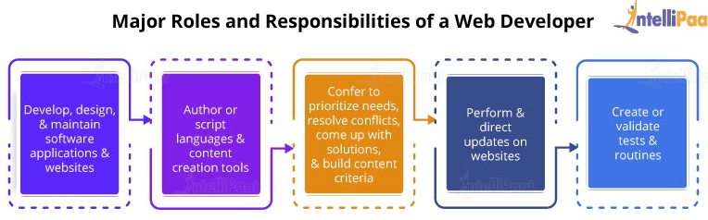
What’s the role of a web developer?
Also known as web programmers or web coders, web developers essentially make a website work by building the functionality, interactivity and visible structure of the site, normally based on the vision of designers and other key roles.
Web developers are also responsible for ensuring a site functions correctly on all browsers - both desktop and mobile - through testing. Once a site is live, a developer carries out updates and other maintenance tasks as necessary.

Slide 10


